Slide 1

FLIPROBO TECHNOLOGIES
Customer Retention Case Study
A case study from Indian e-commerce customers

Slide 2

Table of Contents
Part 1
Introduction
Part 2
Data Visualizations
Part 3
Interpretation of the Results
Part 4
Conclusion

Slide 3
Project Objective:
E-retail factors for customer activation and retention: A case study from Indian e-commerce customers

Slide 4

INTRODUCTION

Slide 5
Business Problem Framing
The objective of this project is to perform data analysis on the customer retention dataset from Indian e-commerce customers and produce valuable insights which will help to retain the customers.
Conceptual Background of the Domain Problem
Customer satisfaction has emerged as one of the most important factors that guarantee the success of online stores; it has been posited as a key stimulant of purchase, repurchase intentions, and customer loyalty. A comprehensive review of the literature, theories, and models have been carried out to propose the models for customer activation and customer retention.

Slide 6
Five major factors that contributed to the success of an e-commerce store have been identified as:
Service Quality System Quality Information Quality Trust
Net Benefit
Data Sources and their formats
The dataset is provided by FlipRobo Technologies. The data is collected from the Indian online shoppers through conducting the survey.
There are two sheets in the dataset one is detailed and the second is encoded in the excel file.

Slide 7

DATA VISUALIZATION

Slide 8
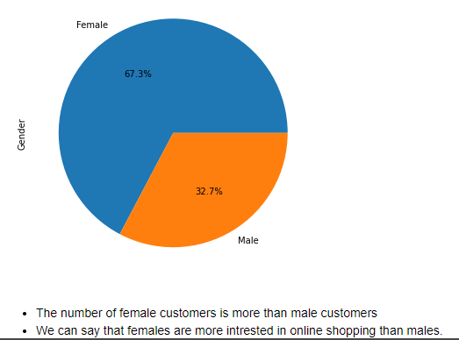
Gender:

Slide 9
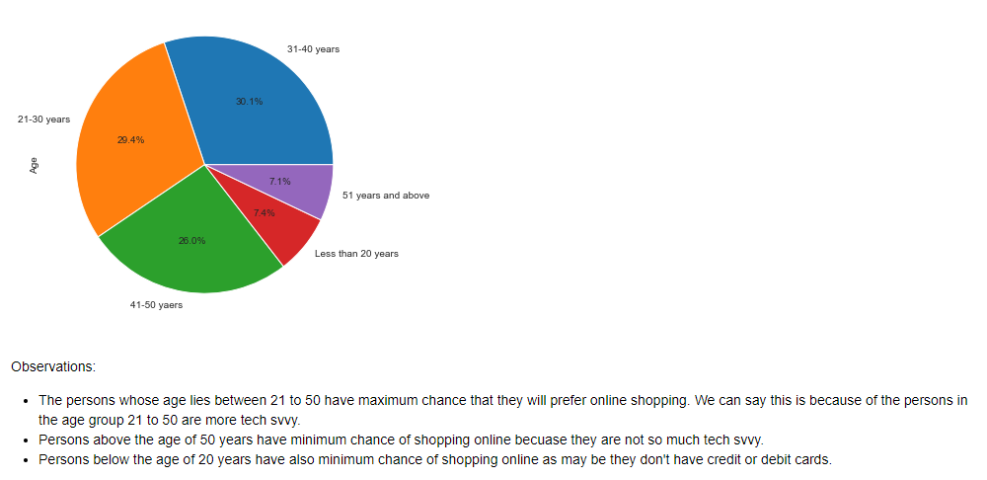
Age:

Slide 10
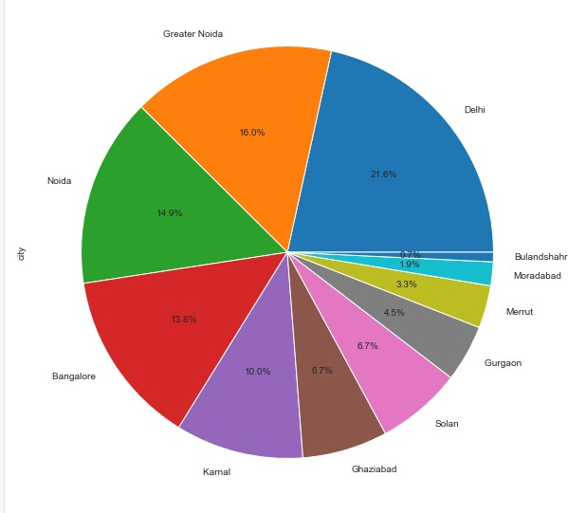
City:

Slide 11
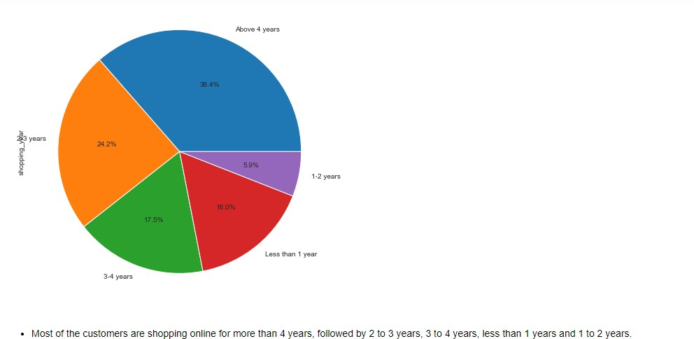
Shopping Year:

Slide 12
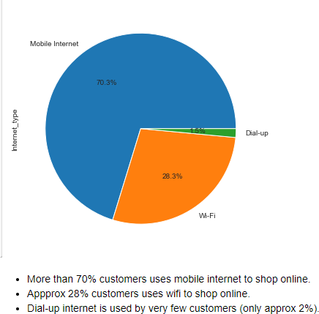
Type of internet used by the customers to shop online:

Slide 13
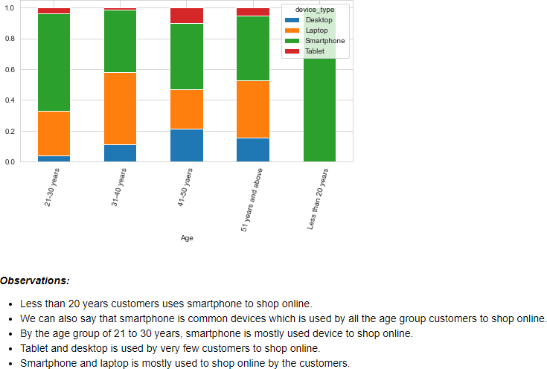
Devices used by the customers to shop online

Slide 14
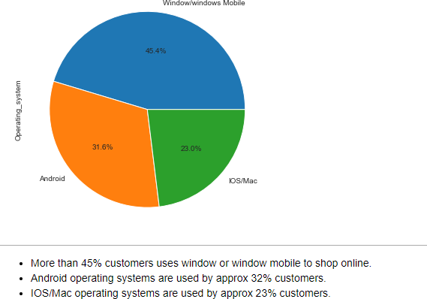
Operating system used by the customers

Slide 15
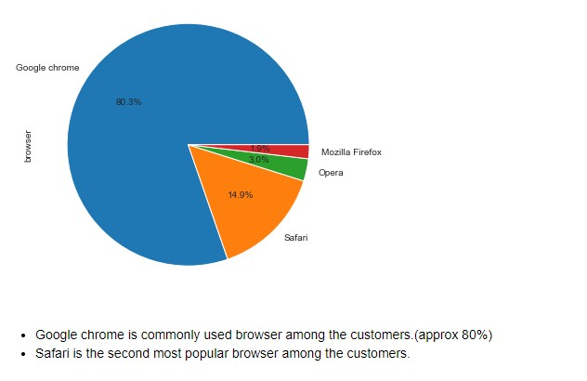
Browser used by the customers to shop online

Slide 16
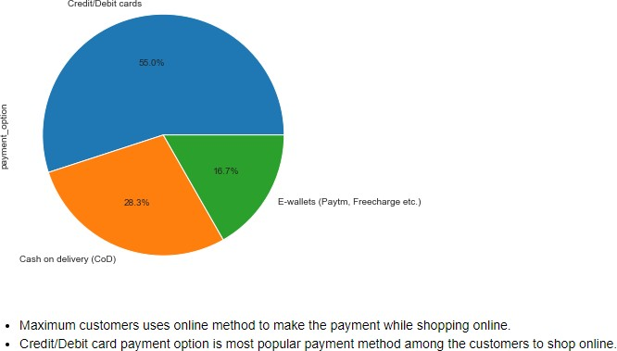
Preferred Payment Options

Slide 17
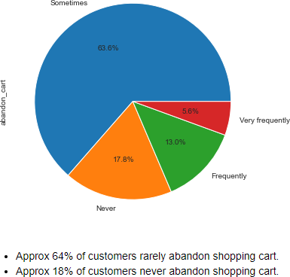
Frequently customers abandon the shopping cart

Slide 18
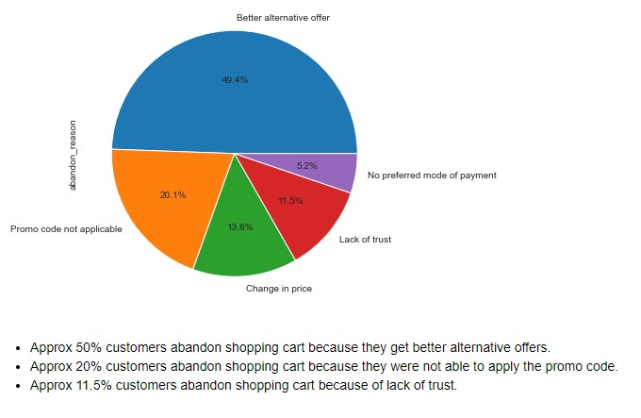
Why customers abandon the shopping cart

Slide 19
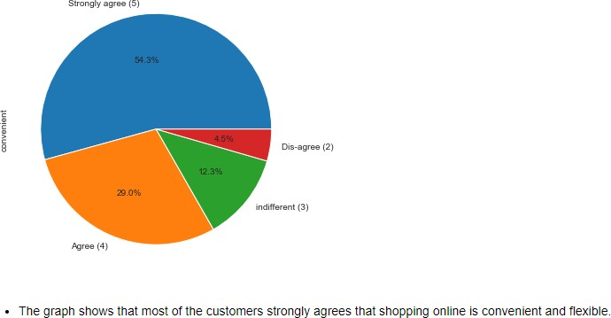
Shopping online is convenient and flexible

Slide 20
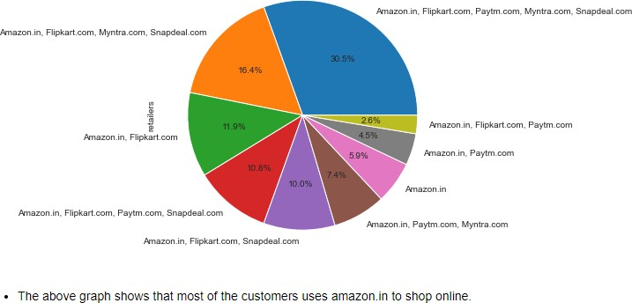
Online retailers from where customers shop online

Slide 21
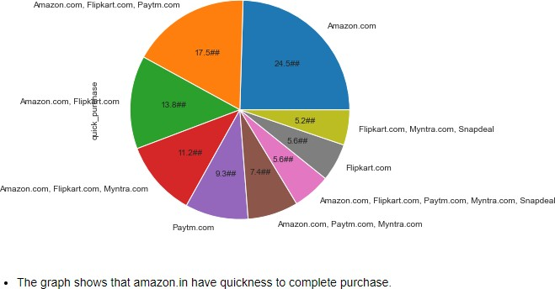
Quickness to complete purchase

Slide 22
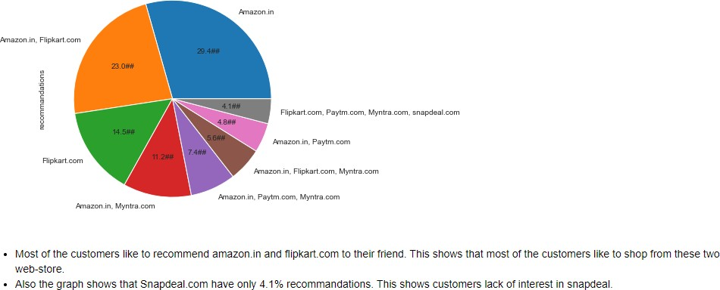
Recommendation:

Slide 23
INTERPRETATION OF THE RESULTS

Slide 24
Top five companies preferred by Indian Customers:
Amazon Flipkart Paytm Snapdeal Myntra
Most customers said that they found amazon.in very easy to use.
Most customers also said that the visual appearance of amazon.in is best among all the online retail websites/applications.
Amazon.in and flipkart.com are selected by most of the customers as these websites have a wide variety of products listed
If we talk about the complete, relevant information related to the products, most of the customers go with amazon.in and flipkart.com

Slide 25
If we talk about the website/application speed and page loading time, amazon.in takes the lead followed by flipkart.com and paytm.com
Talking about the quickness to complete the purchase, most of the customers found that Amazon.in is better but flipkart.com and paytm.com also give tough competition.
Speed of delivery: Amazon is taking lead in this category also followed by flipkart.com
Privacy of customers and their financial information: Amazon is taking lead in this category also. Flipkart.com is also providing better security options for customers.
If we talk about the trust of the customers in the online retailers, we can say Amazon and Flipkart are winners.
As per the customers, amazon.in is as efficient as it was earlier.
Most of the customers want to recommend amazon.in and flipkart.com to their friends. This shows that the majority of the customers have trust in these two companies.

Slide 26
CONCLUSION

Slide 27
Key Findings and Conclusions of the Study:
Online retailers companies should focus on offering the best services to the customers as customer satisfaction is very important for customer retention
Convenience: The website user interface should be user-friendly. As per our analysis, there should be a complete product description on the website/application of the e-stores.
Privacy & Payment Securities: Companies should focus on providing proper privacy and payment securities to the customers as it leads to the trust of the customers which is very much important. Loyalty Programs: One of the best ways to attract customers to shop online is providing them some loyalty programs and rewarding them once they make any purchase or recommend the website/application to any friends.
Website/application technicalities: Companies should focus on the speed of the website and page navigation. As smooth navigation help users to decide faster to make any purchase.

Slide 28

Thank you!

